Slide 1
Fine Tuning BERT for Text Classification
Pratyaksha
Sr.No. 17885

Slide 2
Problem Statement
Study the effect of Fine Tuning BERT for various NLP Tasks
Compare the performance of various Fine Tuning Techniques
Compare the accuracy and execution time for various datasets

Slide 3
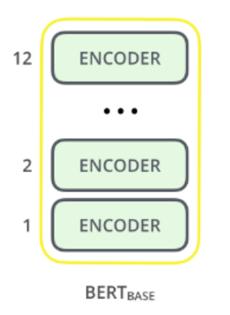
Proposed Approach
Training the entire Architecture
Training some layers while freezing others
Freezing the entire Architecture
Fine tuning the learning rates of different layers
BERT has huge number of parameters: Training small datasets from scratch can lead to overfitting
BERT Base: 12 layers (transformer blocks), 12 attention heads, and 110 million parameters

Slide 4
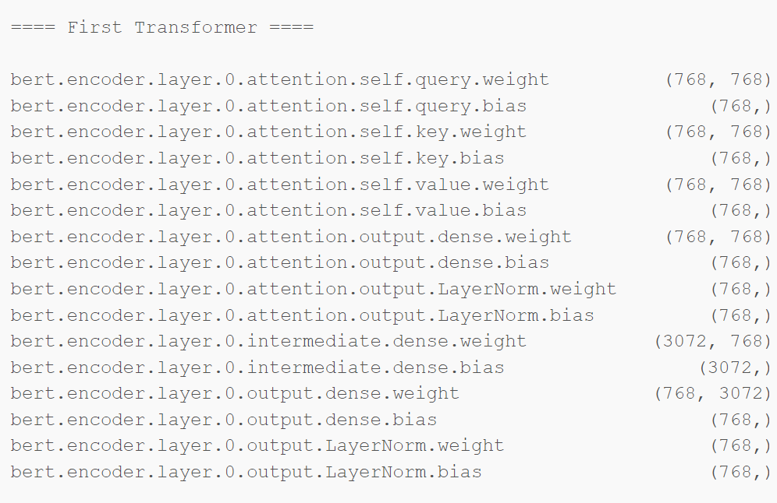
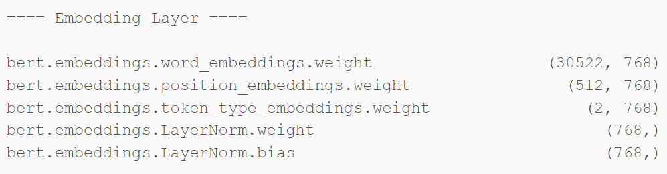
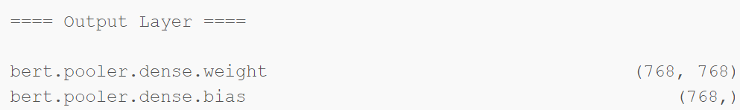
Tuning the Layers of BERT Base (199 Named Parameters)

Slide 5
Tasks Performed
News Classification (5 classes, ~1500 training data)
Tweet Classification (2 classes, ~3000 training data)
Spam Classification (2 classes, ~5572 training data)
IMDB Sentiment Analysis (2 classes, ~20000 training data)
Named Entity Recognition

Slide 6
Results (Tweet Classification)
Strategy | F1 Score | Time Taken
Pretrained BERT | 0.67 | 19 sec
Fine Tuned BERT | 0.82 | 38 sec
Fine Tuned last 4 layers | 0.79 | 20 sec
Fine Tuned mid 4 layers | 0.78 | 44 sec
Fine Tuned first 4 layers | 0.73 | 40 sec
Learning Rate of last 4 layers | 0.80 | 20 sec

Slide 7
Results (News Classification)
Strategy | F1 Score | Time Taken
Pretrained BERT | 0.38 | 26 sec
Fine Tuned BERT | 0.96 | 58 sec
Fine Tuned last 4 layers | 0.95 | 36 sec
Fine Tuned mid 4 layers | 0.88 | 40 sec
Fine Tuned first 4 layers | 0.81 | 46 sec

Slide 8
Results (Spam Classification)
Strategy | F1 Score
Pretrained BERT | 0.46
Fine Tuned BERT | 0.81
Fine Tuned last 4 layers | 0.98
Fine Tuned mid 4 layers | 0.93
Fine Tuned first 4 layers | 0.52

Slide 9
Observations
With Fine Tuning, F1 score on IMDB performance was ~0.88 with just 2 epochs, which is a good improvement over Assignment
For Larger datasets, it is good to fine tune the model rather than training from scratch
Retraining higher layers while freezing lower performs better
Lower layers might have more general features of the language
Higher layers are task specific

Slide 10
Test Results (F1 Score)
Experiment from the assigned article: Pretrained BERT_{LARGE} + Fully Connected Layers + Softmax (0.85)
Additional Experiments
Baseline: Pretrained BERT_{LARGE}+ Softmax (0.81)
Experiment 1: Retrained BERT_{LARGE} + Softmax (0.46)
Experiment 2: Retrained output layer of BERT_{LARGE} + Frozen other layers + Softmax (0.94)
Experiment 3: Retrained encoder layer 24 of BERT_{LARGE} + Frozen other layers + Softmax (0.98)
Experiment 4: Retrained encoder layer 12 of BERT_{LARGE} + Frozen other layers + Softmax (0.93)
Experiment 5: Retrained encoder layer 1 of BERT_{LARGE} + Frozen other layers + Softmax (0.52)

Slide 11
Observations
Retraining BERT took a long time with bad performance
Retraining higher layers while freezing lower performs better
Lower layers might have more general features of the language
Higher layers are task specific

Slide 12
References
https://www.analyticsvidhya.com/blog/2020/07/transfer-learning-for-nlp-fine-tuning-bert-for-text-classification/
https://www.analyticsvidhya.com/blog/2019/09/demystifying-bert-groundbreaking-nlp-framework/?utm_source=blog&utm_medium=fine_tune_BERT
https://mccormickml.com/2019/07/22/BERT-fine-tuning/
https://arxiv.org/pdf/1905.05583.pdf

